Slide 1

Lesson 3: Accessing Local Storage and Databases
David Intersimone “David I” Vice President of Developer Relations and Chief Evangelist
davidi@embarcadero.com

Slide 2
Mobile App Development
Lesson 1 – Hello World! My First Multi-Device App
Lesson 2 – Turning up the Style and Data!
Lesson 3 – Accessing Local Storage and Databases
Lesson 4 – Building Multi-tier, Multi-device Apps
Lesson 5 – Connecting Mobile and Desktop using Tethering
Lesson 6 – Accessing REST and BaaS Cloud Services
Replay links and lesson slides will appear on my blog
http://blogs.embarcadero.com/davidi/

Slide 3
Lesson 3 Agenda
Mobile application local file system access
INI files
FireDAC – SQL databases and in-memory datasets
InterBase®
Samples and Snippets
Continue development of the mobile business app
Review, Homework and Next Time
Q&A

Slide 4
Mobile application local file system access
System.IOUtils, System::Ioutils
Contains a large number of directory, file and path methods
GetHomePath
GetDocumentsPath
GetDirectories, GetFiles
Exists, Delete, Copy
Use device APIs and 3rd party components to get to other non-app file areas
Music – look at Mobile Samples | Media | Music Player
{$IF DEFINED(IOS) or DEFINED(ANDROID)}
FireTaskList.Params.Values['Database'] := TPath.GetDocumentsPath + PathDelim + 'TASKS.GDB';
{$ENDIF}
#if defined(TARGET_OS_IPHONE) || defined(__ANDROID__)
FireTaskList->Params->Values["Database"] = System::Ioutils::TPath::GetDocumentsPath() + PathDelim + "TASKS.GDB";
#endif

Slide 5
INI files
Used to store and retrieve application-specific information and settings
Stores information in logical groupings, called sections: [Example Section Name]
Within each section, actual data values are stored in named keys. Keys take the form: <keyname> = <value>
The FileName is passed to the TIniFile constructor and identifies the INI file that the object accesses
Methods are provided for working with INI files
ReadString / WriteString
ReadInteger / WriteInteger, ReadFloat / WriteFloat
ReadBool / WriteBool, ReadBinaryStream / WriteBinaryStream
ReadDate / WriteDate, ReadTime / WriteTime
ReadSection, ReadSections, SectionExists, EraseSection, DeleteKey, UpdateFile, ValueExists
[MASTSQL]
Database=C:\Users\Public\Documents\Embarcadero\Studio\14.0\Samples\Data\MASTSQL.GDB
User_Name=SYSDBA
Password=masterkey
DriverID=IB

Slide 6
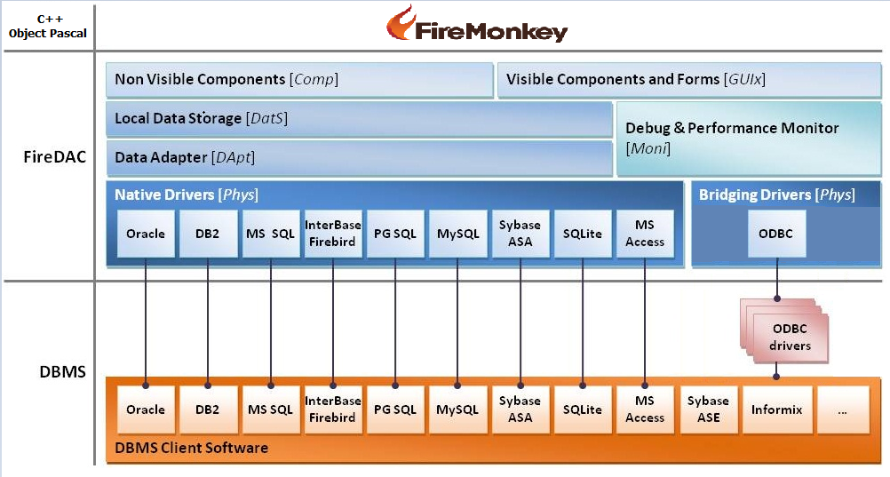
FireDAC – Multi-Device Data Access Library
Direct, high speed access to mobile, desktop and enterprise databases

Slide 7
FireDAC – SQL Databases
Mobile
InterBase XE3 – IBLite, IBToGo
SQLite
Desktop and Enterprise
InterBase
SQLite
MySQL
SQL Server
Oracle
PostgreSQL
DB2
SQL Anywhere, Advantage DB
Firebird
Access
Informix
and more (via ODBC)
Notes:
http://www.embarcadero.com/rad-in-action/no-app-is-an-Island
Cary Jensen webinar with whitepaper and numerous FireDAC demos for download

Slide 8
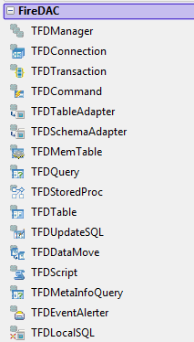
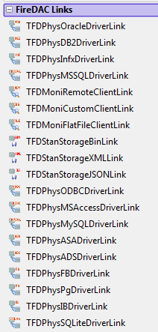
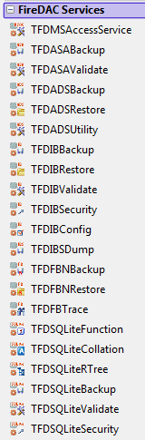
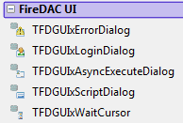
FireDAC Components
Core
UI
Driver& Monitor Links
Services

Slide 9
TFDConnection
FireDAC supports 3 connection definition kinds:
Persistent - Has a unique name, is managed by the FDManager, and is stored in a connection definition file.
Private - Has a unique name, is managed by the FDManager, but is NOT stored in a connection definition file.
Temporary - Has no name, is not stored in a connection definition file, and is not managed by the FDManager.
Persistent connection definitions are stored in the connection definition file.
C:\Users\Public\Documents\Embarcadero\Studio\FireDAC\FDConnectionDefs.ini

Slide 10
TFDTable
The TFDTable has two main operation modes:
Live Data Window mode. Allows bidirectional navigation through large data volumes with a minimal memory usage.
Standard mode. This mode is similar to TFDQuery. TFDTable generates a single SELECT command and uses the result set to walk through table records.
Live Data Window Mode
Queries and keeps in memory only 2 * FetchOptions.RowsetSize of records.
When the application navigates through the table data, FireDAC automatically scrolls or positions the LDW to the required position.
Minimizes memory usage and allows you to work with large data volumes, similarly to an unidirectional dataset.
Enables bidirectional navigation, in contrast to an unidirectional dataset.
Gives always fresh data, reducing the need to refresh the dataset.
Does not give a delay to fetch all result set data, required to perform sorting, record location, jumping to last record, etc.

Slide 11
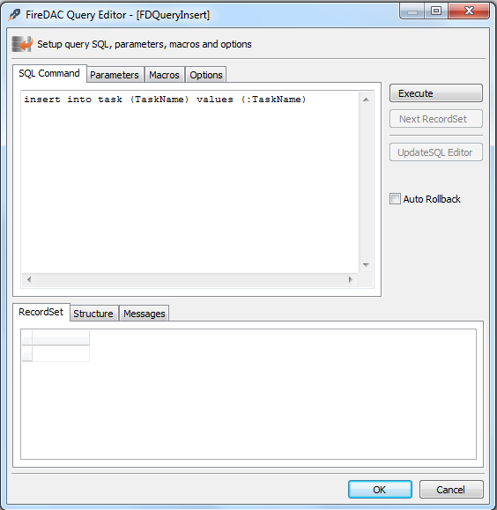
TFDQuery
SQL query statement component
Double-click TFDQuery to invoke the FireDAC Query Editor
Use the Object Inspector to set the Connection, SQL and Active properties
Write code to set the properties and call the ExecSQL() method
You can use the Params property for parameterized queries

Slide 12
TFDMemTable
Use TFDMemTable to manage data in the client memory and optionally exchange the data with a DBMS
You can create and populate a TFDMemTable.
You can load and save TFDMemTable metadata and data to local storage (XML, binary)
You can copy FireDAC datasets to TFDMemTable
with FDMemTable1.FieldDefs do begin
with AddFieldDef do begin
Name := 'f1';
DataType := ftInteger;
end;
with AddFieldDef do begin
Name := 'f2';
DataType := ftString;
Size := 50;
end;
end;
with FDMemTable1 do begin
Open;
Append;
Fields[0].AsInteger := ...;
Fields[1].AsString := ...;
Post;
end;
FDQuery1.Open;
FDQuery1.FetchAll;
FDMemTable1.Data := FDQuery1.Data;
FDMemTable1.First;
while not FDMemTable1.Eof do begin
FDMemTable1.Edit;
.......
FDMemTable1.Post;
FDMemTable1.Next;
end;

Slide 13
FireDAC Master-Detail Relationships
The master-detail relationship allows you to automatically filter a detail dataset based on a current master dataset record. For example, the master dataset has "Order" records, and the detail dataset has "Order Line" records. So the detail dataset shows only lines for the current order.
Special setup is not required for a master dataset.
FireDAC offers two base methods to set up a detail dataset in a master-detail relationship:
Parameter-based. The master dataset field values are assigned to the detail TFDQuery or TFDStoredProc parameters, and then the detail dataset query is reexecuted.
Range-based. The master dataset field values are used to apply a range to the detail dataset. The detail dataset might be any FireDAC dataset with current active index.
These methods can be combined.
FireDAC offers two cached updates modes for the datasets in a master-detail relationship:
Decentralized Cached Updates mode: Each dataset tracks the changes independently of others.
Centralized Cached Updates mode: A few datasets in a master-detail relationship share a single change log. The master dataset can propagate changes to the detail datasets in cascading fashion, including auto-incrementing field values.

Slide 14
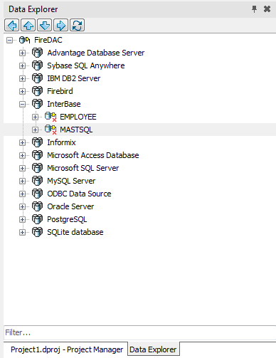
Data Explorer
Add new connections; modify, delete, or rename your connections.
Browse database server-specific schema objects, including tables, fields, stored procedure definitions, stored functions, triggers, and indexes.
Drag and Drop schema objects to the Design Window to create FireDAC components with their connection properties

Slide 15


Local Databases
SQLite | IBLite | InterBase ToGo
Free | Free | Commercial
Feature light | Feature light | Fully featured
No security | No security | Secure Encryption
Simple Data Storage | Full SQL-92 RDBMS | Full SQL-92 RDBMS
Single read/write | Fast multi read/write | Fast multi read/write

Slide 16

InterBase® - Suited to Mobile, Desktop, Server
Overview
Highly scalable, powerful, embeddable database
Small memory and on-disk footprint
Simple installation / deployment
Near zero administration
Encryption built into all paid versions*
Low TCO
Notable Features
Full-featured - SQL92 compliant, SQL Domains, ODBC
ACID compliant / Multi-version architecture
Automatic crash recovery
SMP - Multiple core support
Self-tuning engine
Fully featured in all editions
Some features limited in run-time royalty free IBLite
Database monitoring and statistics built in
Security
Embedded user & role based authentication
Full database, table or column encryption
DES (weak)
AES (strong 256bit) encryption
Decryption by user / user role
Allows developers to focus on creating fast, resilient applications.
Disaster Recovery
Journaling
Data dumps
Partial Backups
Also….
Window Direct I/O support & Amazon EC2 certified

Slide 17


InterBase – Editions
Server Edition
1 to unlimited connections
Desktop Edition
Same as server, but local connections only.
ToGo Edition
Embedded version
IBLite Edition
Feature limited version of ToGo
100mb on disk
No encryption
Single thread connection
Free 90 day Server trial
Full featured server edition
20 users / 80 connections
ToGo Edition
Embedded Version
Developer Edition
20 users / 80 connections
Weak encryption only
Time-limited connection
1,3 SDK Pack
Full featured licenses
Time-limited (Similar to trial)
INSTALLED
TRIAL
EMBEDDED
DEVELOPMENT
*ToGo and IBLite do not offer UDFs on iOS / Android due to platform requirements excluding external libraries in application bundles for security reasons.
Notes:
To suit different projects there are 4 key editions that fall into two categories. “Installed or Embedded”
1,2 Installed product
3,4 Embedded product

Slide 18
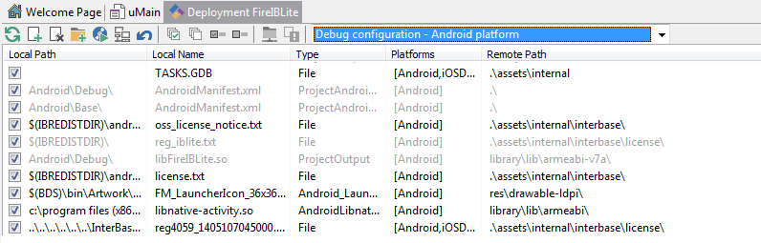
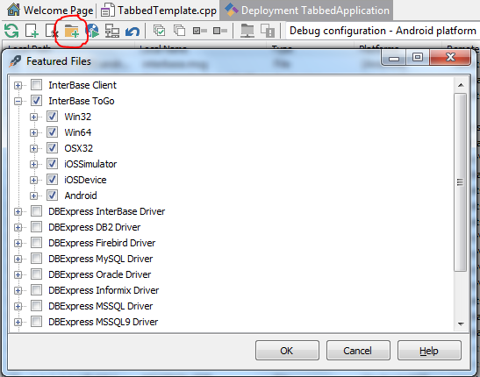
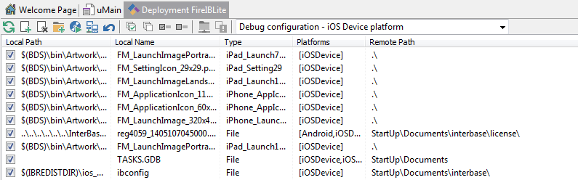
Project Deployment
Add “Feature Files”

Slide 19
FireDAC Samples
Folders
C:\Users\Public\Documents\Embarcadero\Studio\14.0\Samples\CPP\Mobile Snippets
C:\Users\Public\Documents\Embarcadero\Studio\14.0\Samples\Object Pascal\Mobile Snippets
FireDACSQLite
FireDAC_IBLite
Note: As part of your purchase, you will receive an email that includes InterBase XE3 ToGo Test Deployment license and IBLite XE3 Deployment for Mobile Platforms license
“This Embarcadero product also entitles you to a free IBLite for iOS database deployment license. To activate your deployment license, go to https://reg.embarcadero.com/srs6/activation.do and enter the IBLite for iOS serial number above and Registration Code: xxx.”

Slide 20
Next Steps for our Business Mobile App
Connect to MASTSQL database using FireDAC
Customer table
Master Query for Customer List
Detail Query for Orders by Customer – connect to ListView
Customer List binding to Listview
Customer selection brings up TabItem with Customer Info (ListBox) and Orders ListView
Order selection brings up TabItem with a ListBox
Employee table
Parts table

Slide 21
Lesson 3 Review
You can access the local storage for your mobile app
Use INI files for application settings persistence
FireDAC for local SQL database access – SQLite and IBLite/IBToGo
Continued work on the business mobile app

Slide 22
Resources
IOUtils - Docwiki
http://docwiki.appmethod.com/appmethod/1.14/topics/en/Standard_RTL_Path_Functions_across_the_Supported_Target_Platforms
http://docwiki.appmethod.com/appmethod/1.14/topics/en/Disk_And_Directory_Support_Routines
http://docwiki.appmethod.com/appmethod/1.14/topics/en/Path_Manipulation_Routines
INI Files – Docwiki
http://docwiki.appmethod.com/appmethod/1.14/topics/en/Using_TIniFile_and_TMemIniFile
FireDAC - DocWIki
http://docwiki.appmethod.com/appmethod/1.14/topics/en/FireDAC
http://docwiki.appmethod.com/appmethod/1.14/topics/en/Overview_(FireDAC)
http://docwiki.appmethod.com/appmethod/1.14/topics/en/Getting_Started_(FireDAC)
http://docwiki.appmethod.com/appmethod/1.14/topics/en/Components_(FireDAC)
http://docwiki.appmethod.com/appmethod/1.14/topics/en/Master-Detail_Relationship_(FireDAC)
http://docwiki.appmethod.com/appmethod/1.14/topics/en/Data_Explorer
http://docwiki.appmethod.com/appmethod/1.14/topics/en/Mobile_Tutorial:_Using_FireDAC_and_SQLite_(iOS_and_Android)
Blogs
http://blogs.embarcadero.com/
Jim McKeeth - http://delphi.org/
Sarina Dupont - http://blogs.embarcadero.com/sarinadupont/
Note: http://docwiki.appmethod.com/appmethod/1.14/topics/en/... = http://docwiki.embarcadero.com/RADStudio/XE6/en/...

Slide 23
Homework & Next Time
Take a look at more mobile samples and snippets for FireDAC
Explore the Docwiki articles and tutorials listed on the Resources page
Continue work on the business mobile app
Lesson 4 – Building Multi-tier, Multi-device Apps
Mullti-Tier architectures
DataSnap REST Application server
Stand-alone FireMonkey application
Stand-alone console application
ISAPI dynamic library
Apache dynamic link mobile
Mobile and Desktop DataSnap client applications
Note: http://docwiki.appmethod.com/appmethod/1.14/topics/en/... = http://docwiki.embarcadero.com/RADStudio/XE6/en/...

Slide 24
Q&A

Slide 25
Thank You ☺
davidi@embarcadero.com

